Slide 1
Patient-Centered Dosing Initiative
Medical Oncologists Survey Results
Regarding Patients with Metastatic Breast Cancer (MBC)
Compiled by Anne Loeser on behalf of the PCDI
May 28, 2021

Slide 2
SURVEY OVERVIEW
Survey Objectives:
Expand current knowledge regarding the prevalence and severity of patients’ treatment-related side effects
Ascertain the level of physician-patient communication about side effects
Increase understanding of the impact of lower doses on patients’ clinical outcomes with respect to efficacy and Quality of Life
Determine physicians’ willingness to discuss drug dosing options with patients based upon the patient’s unique personal attributes
Survey Eligibility Criteria: US-based medical oncologists with experience treating patients with MBC
Participation: 131 responses were received, 12 of which were disqualified due to not meeting the eligibility criteria.

Slide 3
SURVEY RESULTS - HIGHLIGHTS
82% of respondents had been in practice > 5 years, and 85% specialized in breast cancer
87% had started patients on a lower initial treatment dose, the 3 most common reasons being:
Patient’s inability to tolerate the standard dose (89%)
Patients had hepatic/renal dysfunction (89%)
Patients’ current or historical blood counts (64%)
Top 3 drugs/drug classes with reduced starting doses:
Capecitabine (91%)
Taxanes (60%)
Palbociclib (50%)
59% of oncologists indicated that patients felt better on the lower starting dose and that efficacy was similar to the standard dose
Perception about whether the standard dose is always more effective than a lower dose:
85% said No (64% based this belief upon personal observation)
5% said Yes (83% of whom indicated that there was insufficient data regarding lower dose efficacy)
10% were uncertain

Slide 4
SURVEY RESULTS – SIMILARITIES TO MBC PATIENT SURVEY
Top side effect mitigation strategies reported by both oncologists and patients:
Lower the dose
Prescribe medication for alleviation
Provide suggestions for side effect palliation
71% of oncologists indicated that patients given a dose reduction to relieve side effects felt better on the reduced dose, and that efficacy was similar to the standard dose. 71% of patients who received a dose reduction for side effect mitigation indicated that they felt better on the lower dose, and another 12% said they felt better initially, and then felt the same (patients were not asked about efficacy).
97% of oncologists would be willing to discuss dosing options with patients in the future based upon the patient’s personal attributes, and 92% of patients would be willing to engage in these discussions.

Slide 5
SURVEY RESULTS – DIFFERENCES: ONCOLOGISTS VS. PATIENT SURVEYS
100% of oncologists indicated that they inquire about patients’ side effects at every visit, whereas 77% of patients indicated that this was the case.
84% of patients indicated that they experienced a bad treatment-related side effect and informed their oncologists accordingly. 78% of oncologists estimated that < 80% of their patients had a bad treatment-related side effect.
20% of patients with a bad side effect stated that they visited the ER/hospital as a result, whereas two-thirds (66%) of oncologists underestimated this percentage.
43% of patients with a bad side effect stated that they had to miss treatment as a result, and half (50%) of oncologists underestimated this percentage.
100% of oncologists whose patients reported a bad side effect indicated that they had lowered their dose, whereas 66% of patients with a bad side effect (who told their doctor and received assistance) indicated that their dose was reduced.
85% of oncologists do not believe the standard dose is always more effective than a lower dose, whereas 53% of patients share this belief.

Slide 6
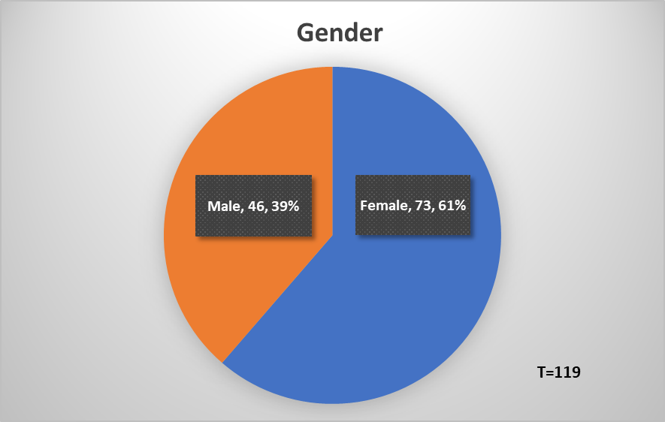
SURVEY RESULTS – GRAPHS AND CHARTS

Slide 7
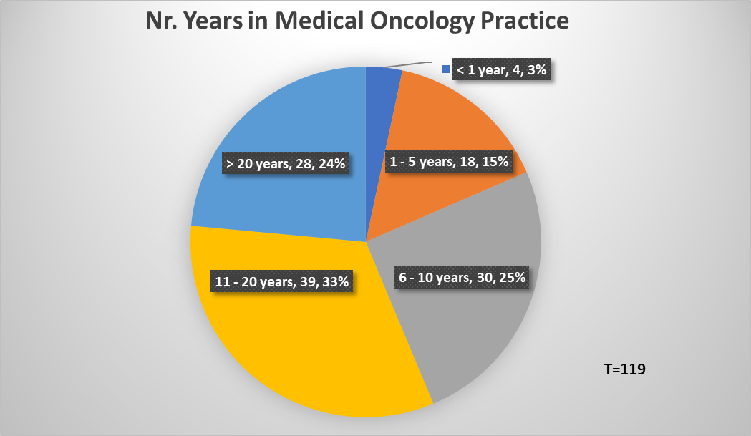
SURVEY RESULTS – GRAPHS AND CHARTS (Cont’d.)

Slide 8
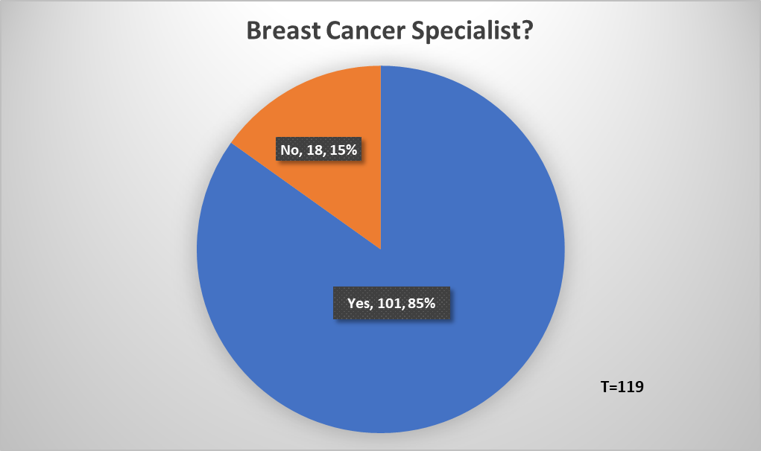
SURVEY RESULTS – GRAPHS AND CHARTS (Cont’d.)

Slide 9
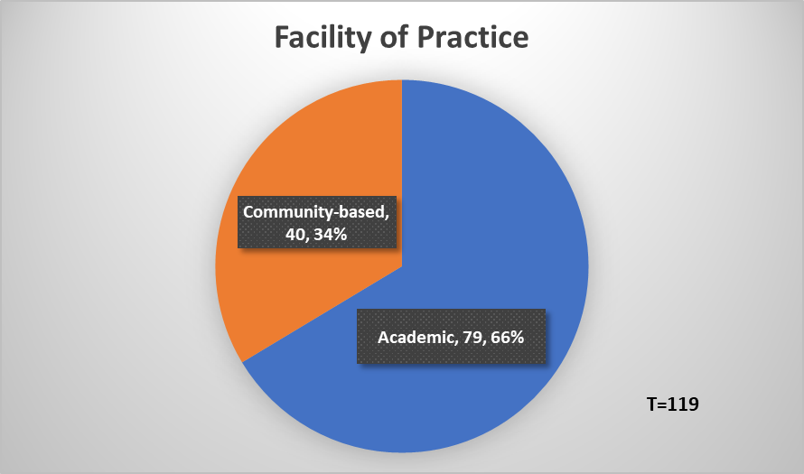
SURVEY RESULTS – GRAPHS AND CHARTS (Cont’d.)

Slide 10
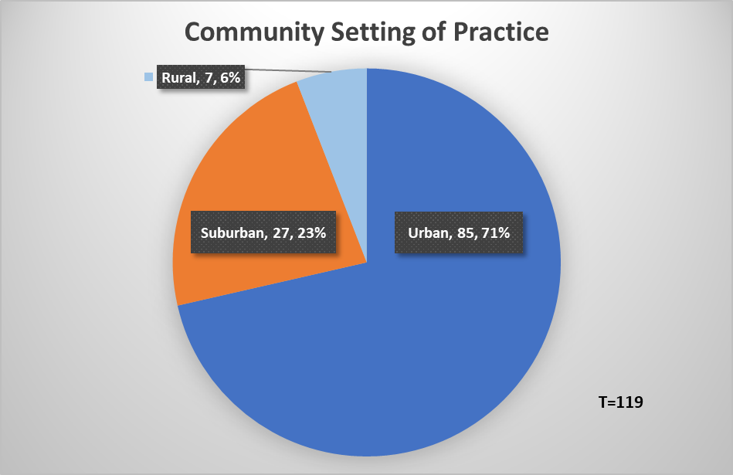
SURVEY RESULTS – GRAPHS AND CHARTS (Cont’d.)

Slide 11
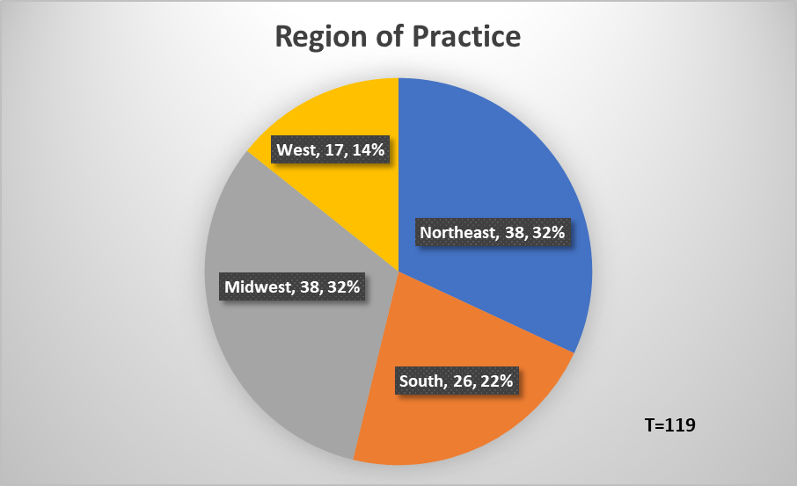
SURVEY RESULTS – GRAPHS AND CHARTS (Cont’d.)

Slide 12
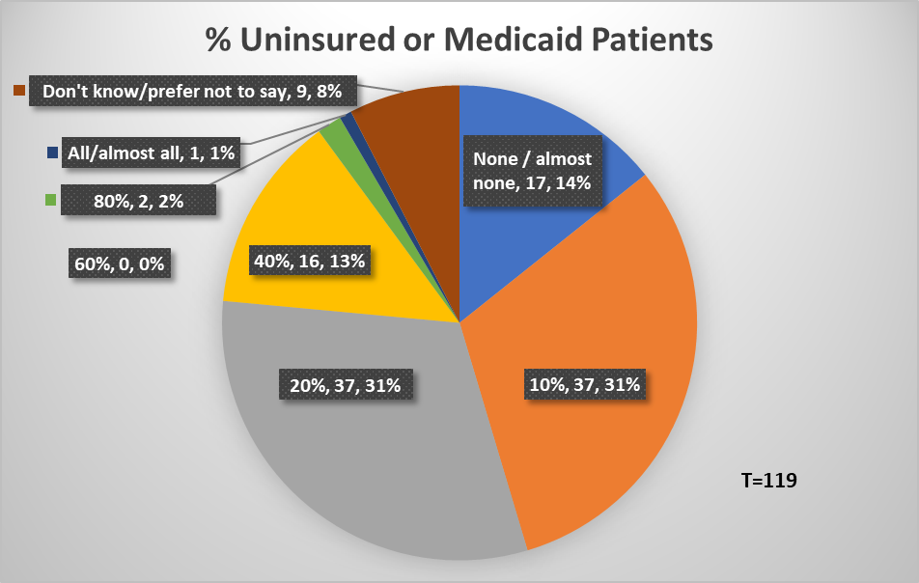
SURVEY RESULTS – GRAPHS AND CHARTS (Cont’d.)

Slide 13
SURVEY RESULTS – GRAPHS AND CHARTS (Cont’d.)

Slide 14
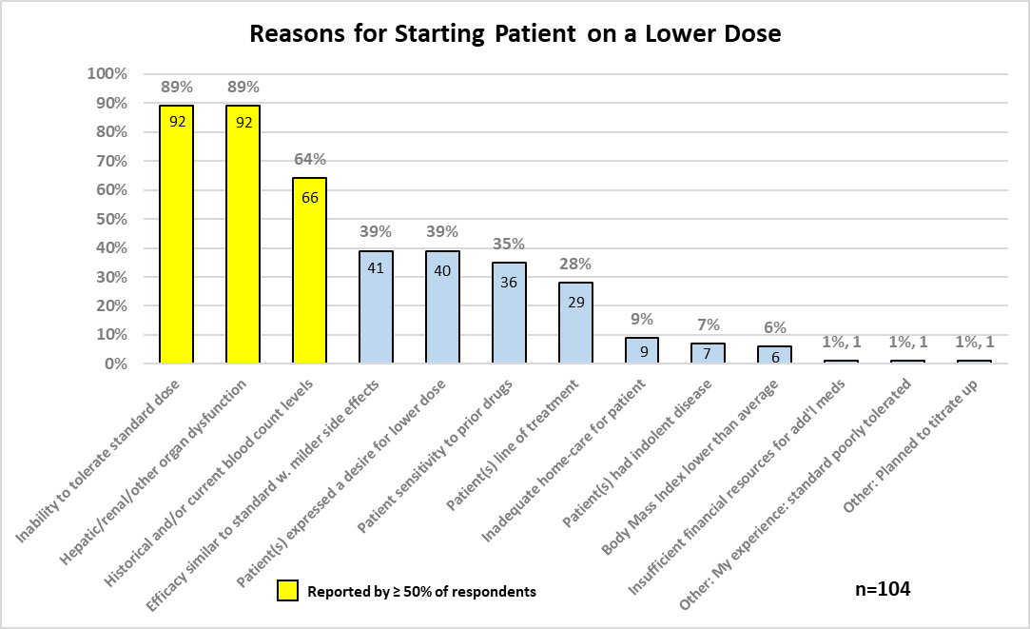
SURVEY RESULTS – GRAPHS AND CHARTS (Cont’d.)
Reported by ≥ 50% of respondents

Slide 15
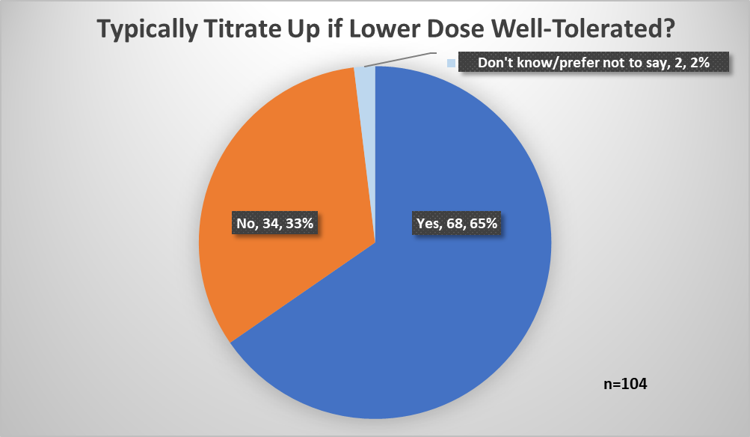
SURVEY RESULTS – GRAPHS AND CHARTS (Cont’d.)

Slide 16
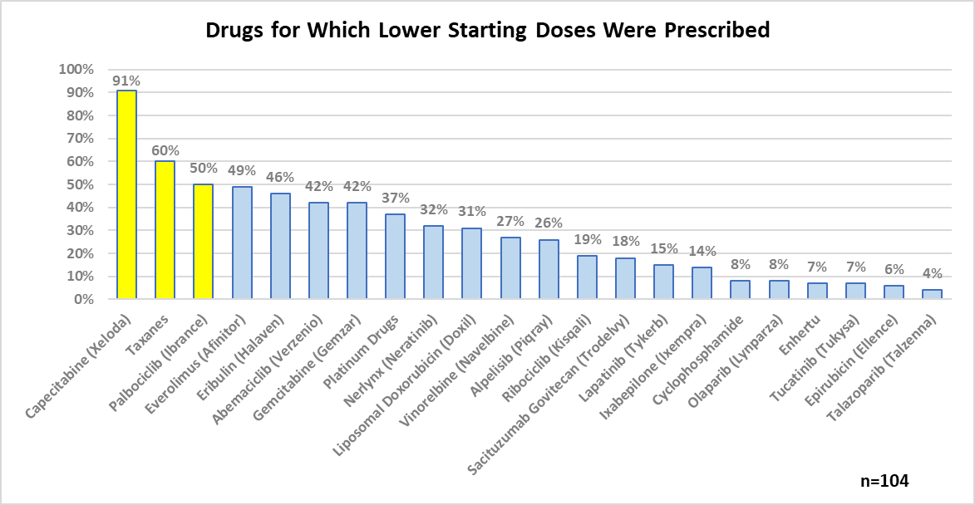
SURVEY RESULTS – GRAPHS AND CHARTS (Cont’d.)

Slide 17
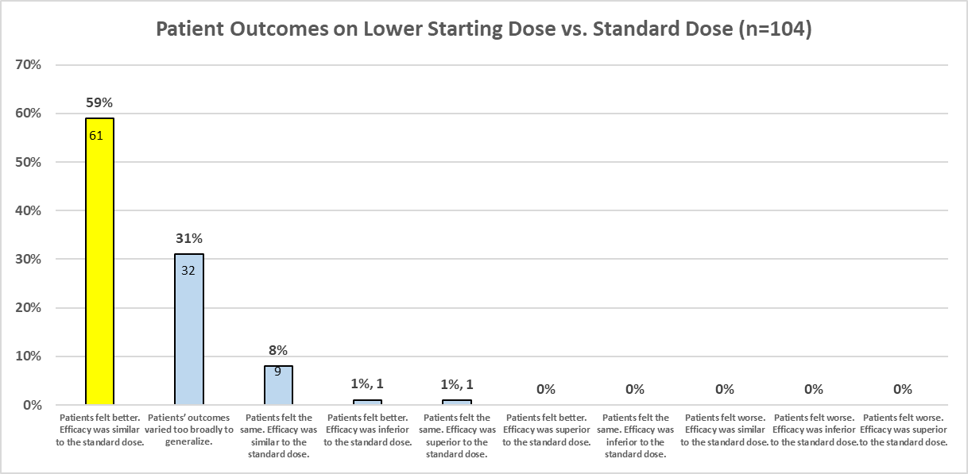
SURVEY RESULTS – GRAPHS AND CHARTS (Cont’d.)
100%

Slide 18
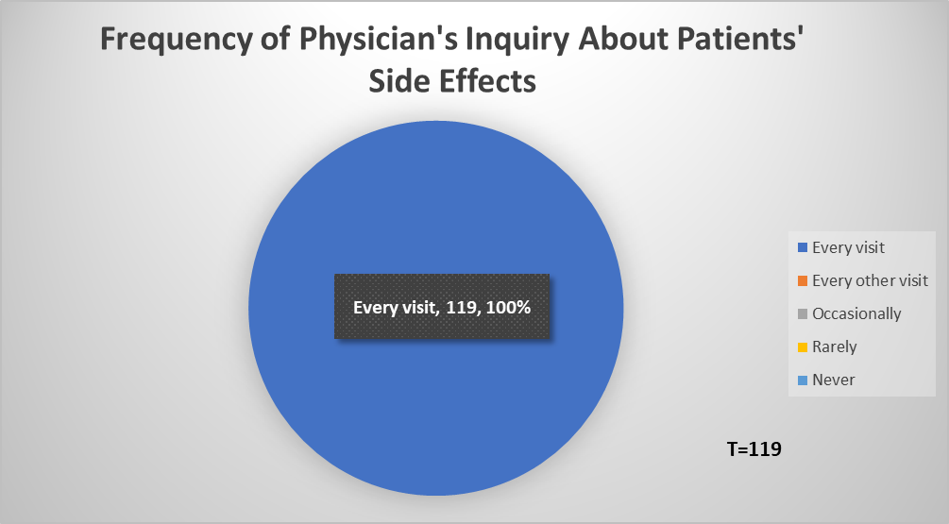
SURVEY RESULTS – GRAPHS AND CHARTS (Cont’d.)
In the Patient Survey when asked how frequently their doctor inquired about side effects:
77% checked “Every visit”
2% checked “Every other visit”
11% checked “Occasionally”
7% checked “Rarely”
3% checked “Never”

Slide 19
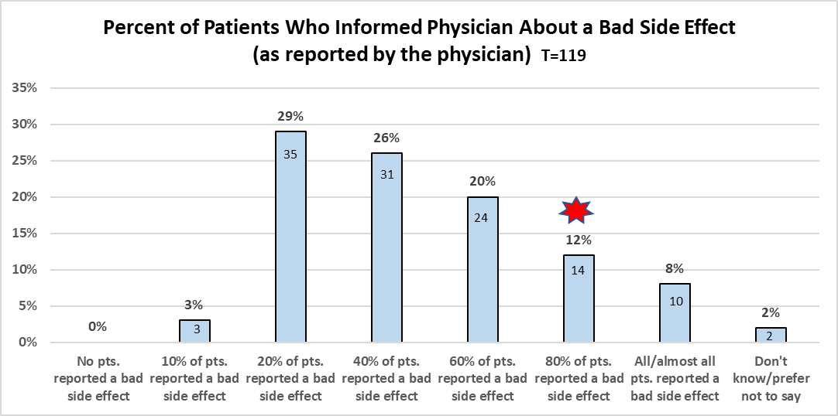
SURVEY RESULTS – GRAPHS AND CHARTS (Cont’d.)
86% of patients with MBC
who responded to the
Patient Survey
reported at least one
bad treatment-related
side effect, and 98% of
them informed their
physician.
Hence 84% of all patients
who took the survey
experienced a bad side
effect and told their doctor.
100%

Slide 20
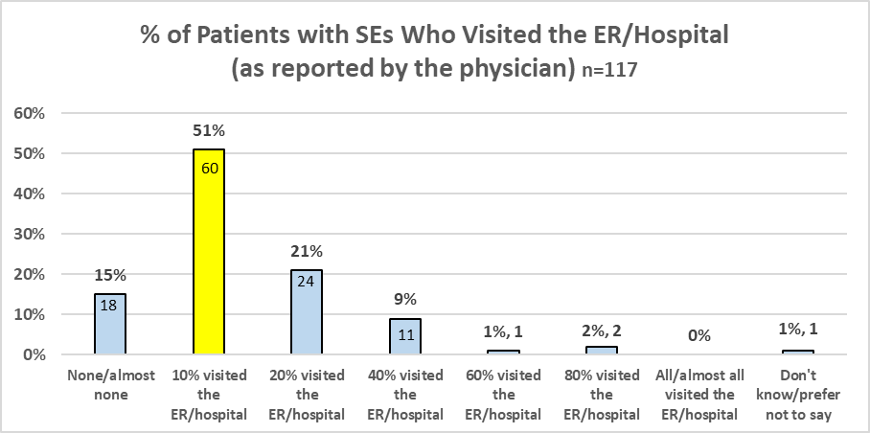
SURVEY RESULTS – GRAPHS AND CHARTS (Cont’d.)
84% of patients who
took the Patient Survey
experienced a bad side
effect and told their
doctor. Of these, 20%
visited the ER/hospital as
a result of SEs (17% of all
patients).
100%

Slide 21
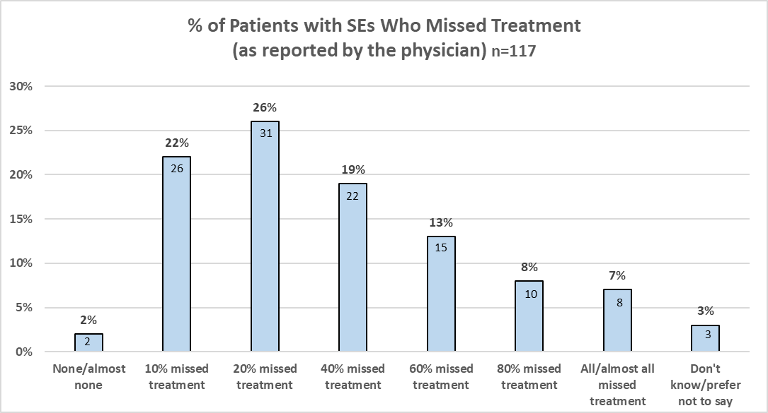
SURVEY RESULTS – GRAPHS AND CHARTS (Cont’d.)
84% of patients who
took the Patient Survey
experienced a bad side
effect and told their
doctor. Of these, 43%
missed at least one
treatment as a result
(37% of all
patients).
100%

Slide 22
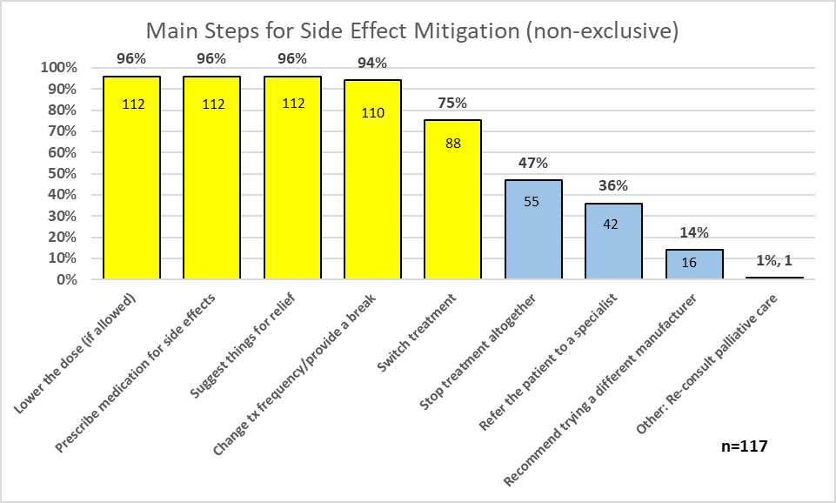
SURVEY RESULTS – GRAPHS AND CHARTS (Cont’d.)
Congruent with the top three mitigation strategies reported by patients in the Patient Survey.

Slide 23
SURVEY RESULTS – GRAPHS AND CHARTS (Cont’d.)
66% of patients who participated in the Patient Survey who reported a bad side effect to their doctor (and received assistance) indicated that their doctor lowered their dose.
NOTE: Since 100% of physicians indicated that they lowered the dose for patients with bad side effects, there was no occasion to view a follow-up question inquiring why they did not lower the dose.

Slide 24
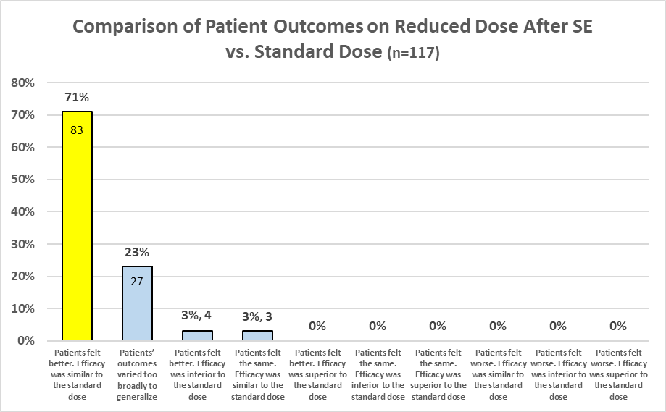
SURVEY RESULTS – GRAPHS AND CHARTS (Cont’d.)
As per the Patient Survey, of the patients who were given a dose reduction for side effect mitigation:
71% felt better
Another 12% felt better initially, and then felt the same
(Patients were not asked about efficacy).
100%

Slide 25
SURVEY RESULTS – GRAPHS AND CHARTS (Cont’d.)
In the Patient Survey, when asked whether a higher dose is always more effective than a lower dose:
53% said No
20% said Yes
27% were not sure

Slide 26
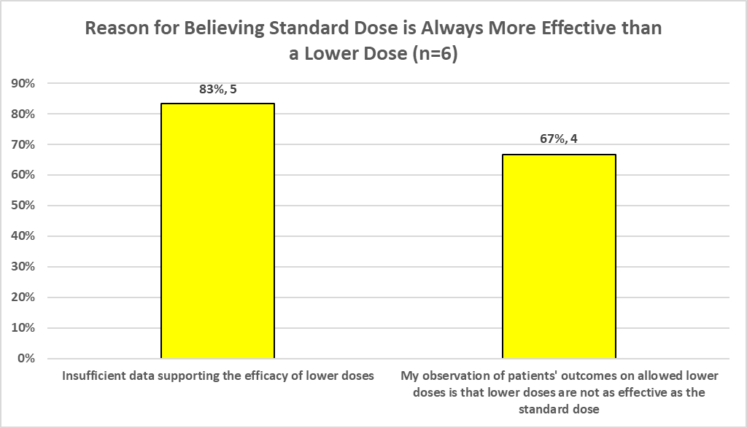
SURVEY RESULTS – GRAPHS AND CHARTS (Cont’d.)

Slide 27
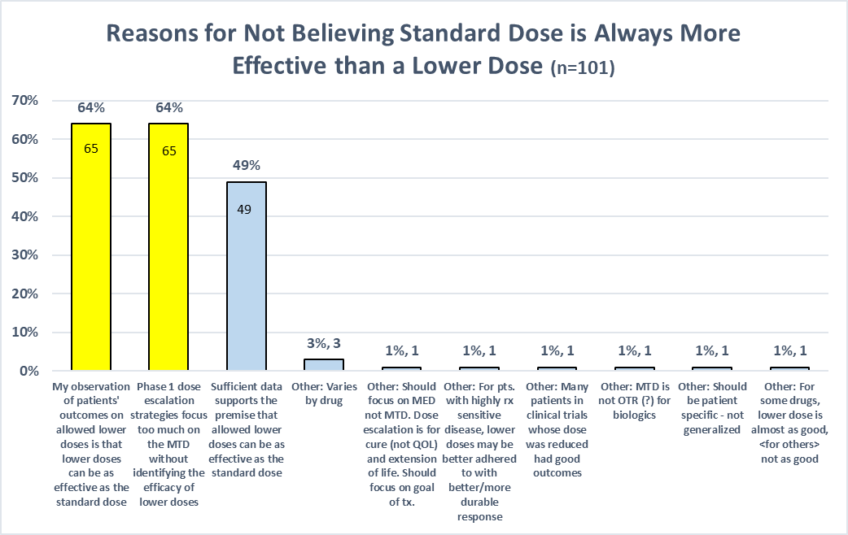
SURVEY RESULTS – GRAPHS AND CHARTS (Cont’d.)

Slide 28
SURVEY RESULTS – GRAPHS AND CHARTS (Cont’d.)
Congruent with Patient Survey whereby 92% of patients indicated they would be willing to engage in these discussions with their physicians.

Slide 29
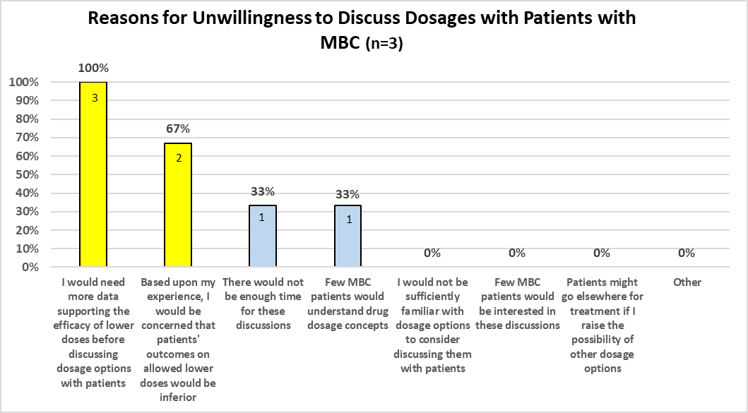
SURVEY RESULTS – GRAPHS AND CHARTS (Cont’d.)
In the Patient Survey, of the 11 individuals (1%) who would not be willing to discuss dosages with their physicians, 4 patients indicated they do not have confidence that a lower dose would be effective.

Slide 30
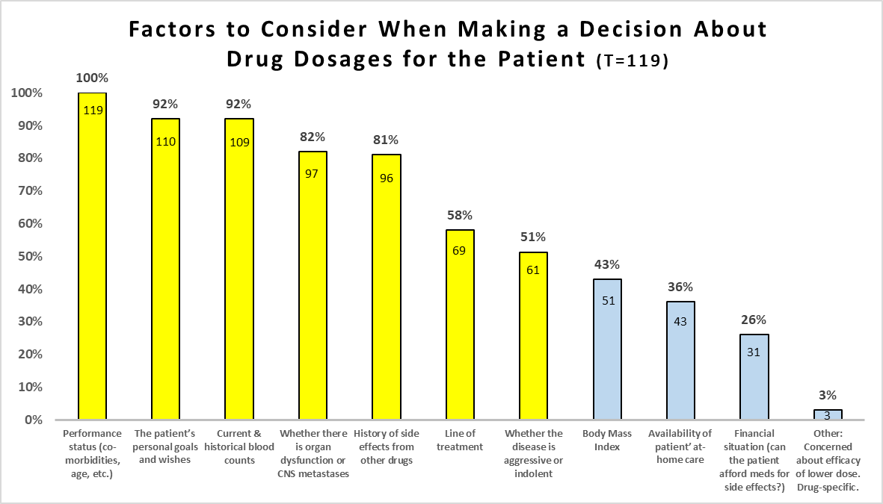
SURVEY RESULTS – GRAPHS AND CHARTS (Cont’d.)

Slide 31
EXCERPTS OF ONCOLOGISTS’ COMMENTS
Individualization
Dose adjustments require an individualized discussion. While some patients would prefer to be on the minimum effective dose, others are reluctant to pursue with dose reductions, particularly if they feel that they are deriving benefit from treatment. So, like other decisions, this requires good communication and an effort to understand patients' preferences and expectations, so that an informed decision can be made.
Every patient and situation is individual.
Need to be able to have a comprehensive evaluation of patient and drug characteristics.
I use lower doses all the time, and vary dose by tolerance, as well as all of the factors we have included above. It is critical to be able to vary dose based on the individual, as well as the biology of their cancer. it is quite likely that lower doses are less effective in some cases, but this can be sorted out as treatment is ongoing.

Slide 32
ONCOLOGISTS’ COMMENTS (Cont’d.)
QOL/Palliative Care
I think the Maximum Tolerated Dose (MTD) is for safety purposes, and if curability is the goal, I think minimum effective dose is much better target for palliative treatment and in targeted therapy specifically.
In some cases, it may be prudent to go a step further and move to best supportive care rather than reduce dose, particularly for late line therapy or indolent disease.
Involve palliative care
Important to consider dose-reductions and alleviation of side effects to maintain optimal quality of life for patients living with MBC - as this is lifelong for them - while still maintaining efficacy.

Slide 33
COMMENTS (Cont’d.)
Concerns
Patients should be informed of the uncertainties of benefit/harms ratios by lowering dose.
And Lastly but Importantly…
“Great idea to think about”
Should be an important consideration to all oncologist treating MBC patients for all above listed considerations

